Slide 1
Recarnation
Team – TechTitans Team Members – Apoorva Shastry Junie Mariam Varghese Nitya Reddy Yerram Rinku Tekchandani

Slide 2
The Problem : Navigating the Used Car Market
Navigating the Used Car Market
The increasing need for cost-effective and eco-friendly transportation has led to notable expansion in the used car market. Our project tackles this demand by creating a user-friendly, secure web application that streamlines this process.
A Complex Seller Journey
Sellers, meanwhile, find the process equally daunting. Listing their cars, dealing with inquiries, negotiating prices, and handling logistics – the experience can be time-consuming and stressful.

Slide 3
Our Solution : ReCarNation Platform
1
Seamless User Experience
2
Comprehensive Features
ReCarNation offers a simplified, intuitive interface, making it easy for buyers to find their dream car and for sellers to list their vehicles.
Our platform features advanced search and filtering tools, detailed car listings, and a comprehensive administration system.
3
Trust and Transparency
We prioritize trust and transparency through strict verification processes, and secure communication channels.

Slide 4
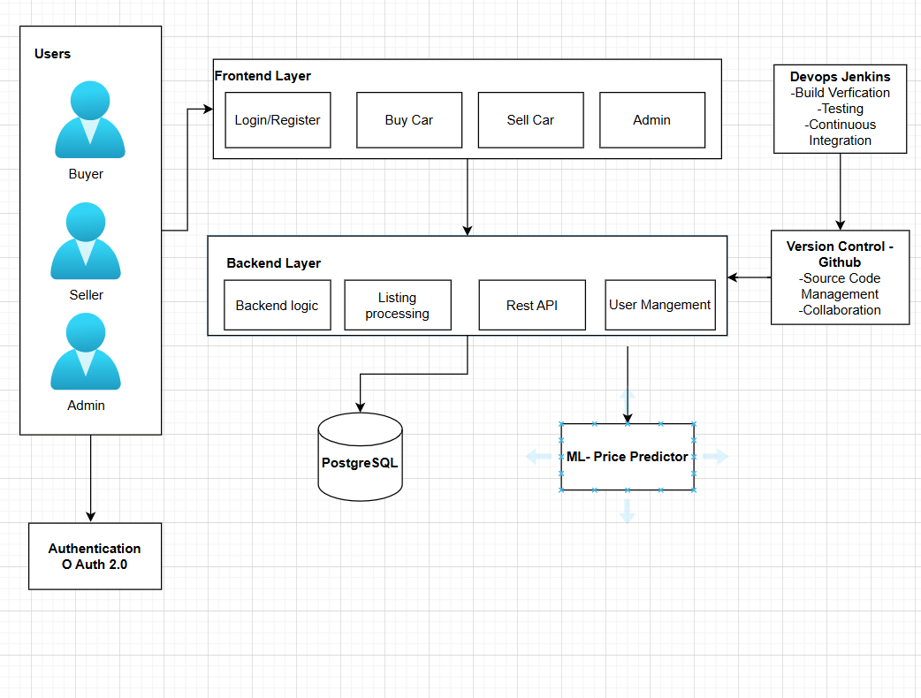
At a Glance
Architecture Diagram
Key Features
Sign In & Sign Up – Users can securely register and login using Oauth 2.0
Buy Car - Advanced search and filtering for finding vehicles
Sell Car - Intuitive forms for listing cars with detailed information.
Admin - Robust control panel for managing users and listings.
Price Predictor - Vehicle price prediction using linear regression

Slide 5
Technology Stack: Building a Robust Platform
Frontend: HTML, CSS, Javascript– Responsive, dynamic UI with advanced search and filtering.
Backend: Django – Handles business logic
ML Model: Linear Regression using libraries like Pandas, Numpy, Matplotlib
Database: PostgreSQL – Reliable and scalable relational database.
CI/CD: Jenkins – Automates building, testing, integration
Authentication: OAuth 2.0
Version Control: Github for code management and collaboration

Slide 6
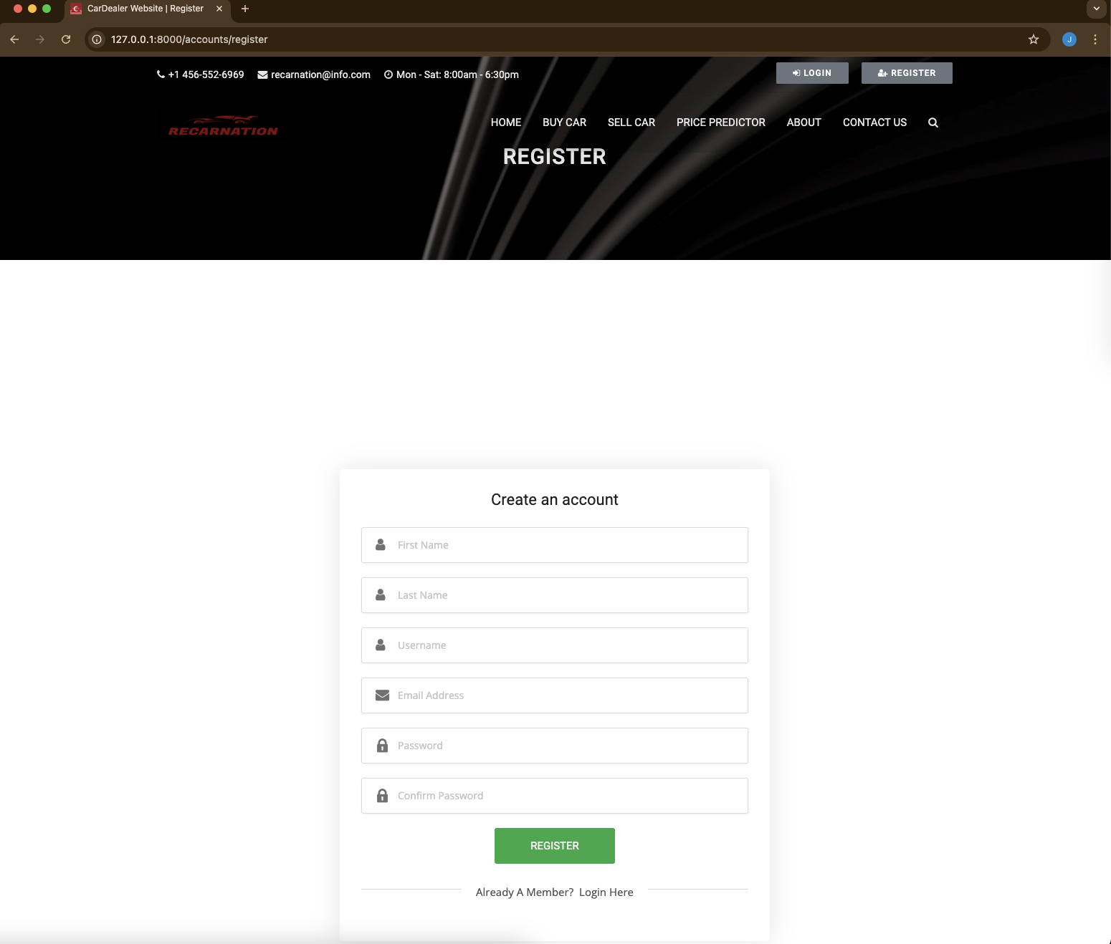
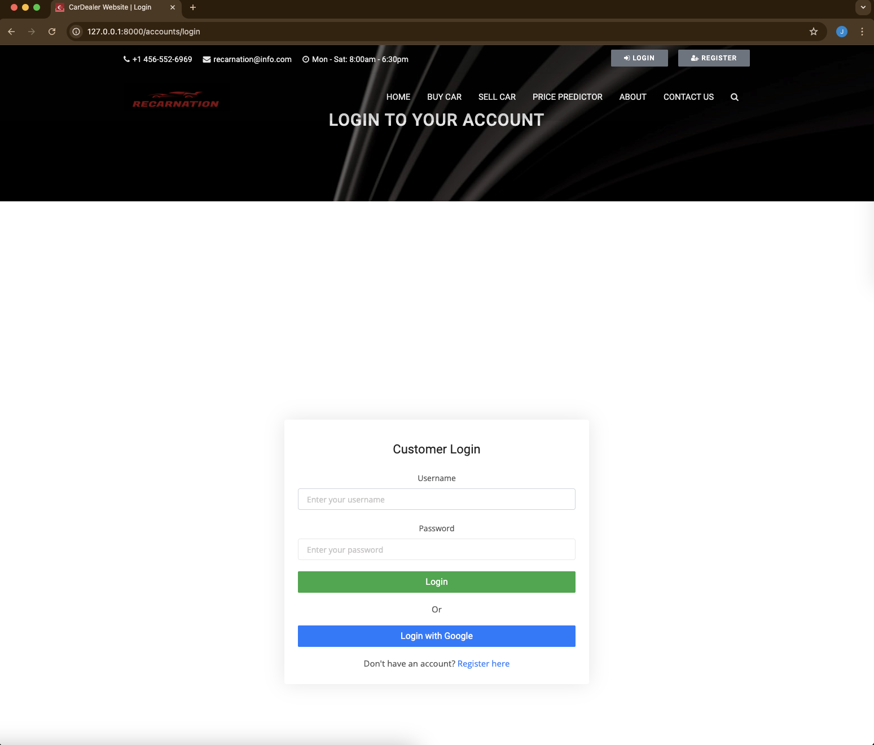
Sign up and Sign In
Users can register via a simple form. Secure login via username/email and password.
OAuth integration for Google.
Credentials are verified via Django Allauth backend.

Slide 7
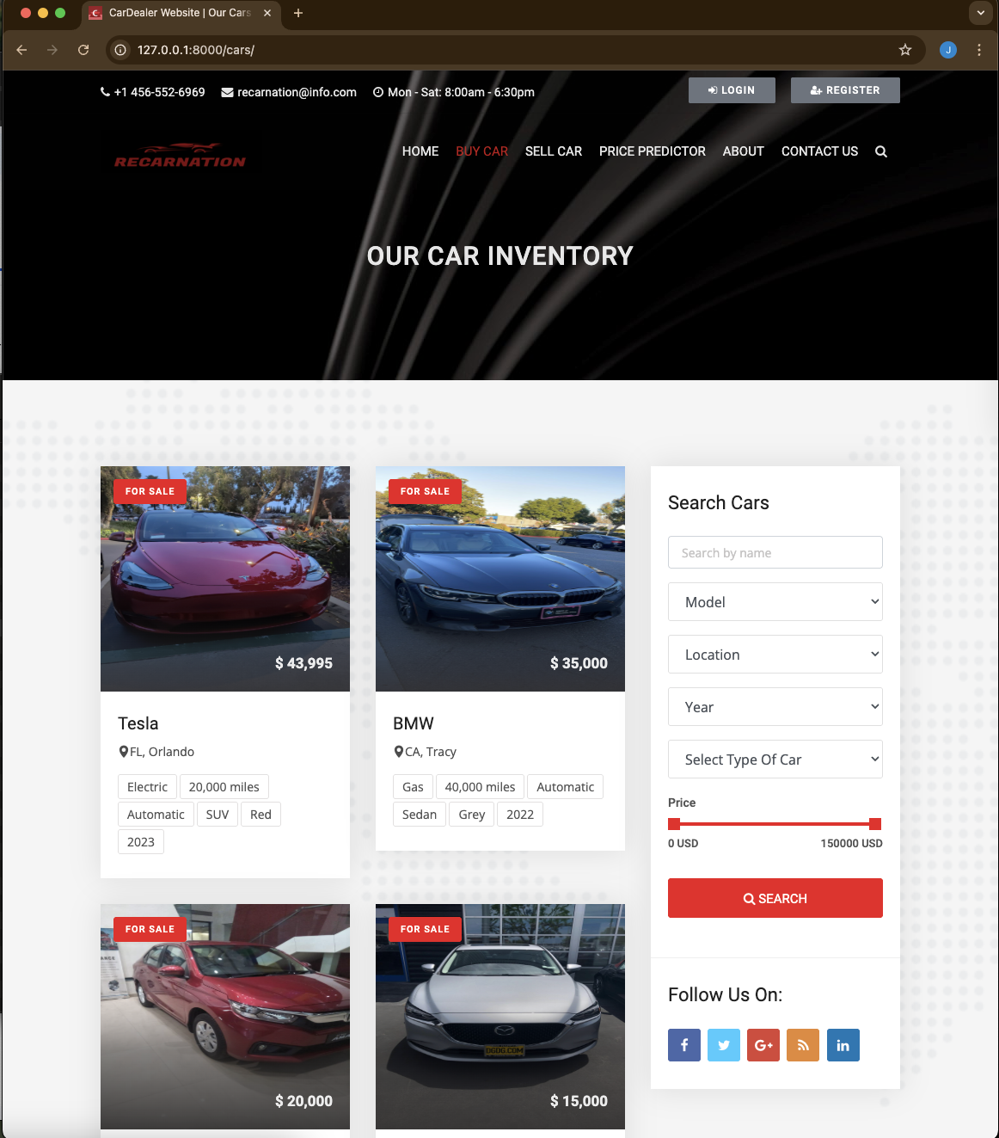
Buyer Journey - A User-Friendly Experience
Landing Page
1
Our landing page features a sleek design and intuitive navigation, guiding users to the right tools and information.
Search and Filtering
2
The search bar and filters allow buyers to quickly narrow down their options based on make, model, year, price.
Listing Details
3
Each listing provides comprehensive details about the vehicle, including photos, vehicle history reports.
Secure Communication
4
Buyers can communicate with sellers through email by sending a message .

Slide 8
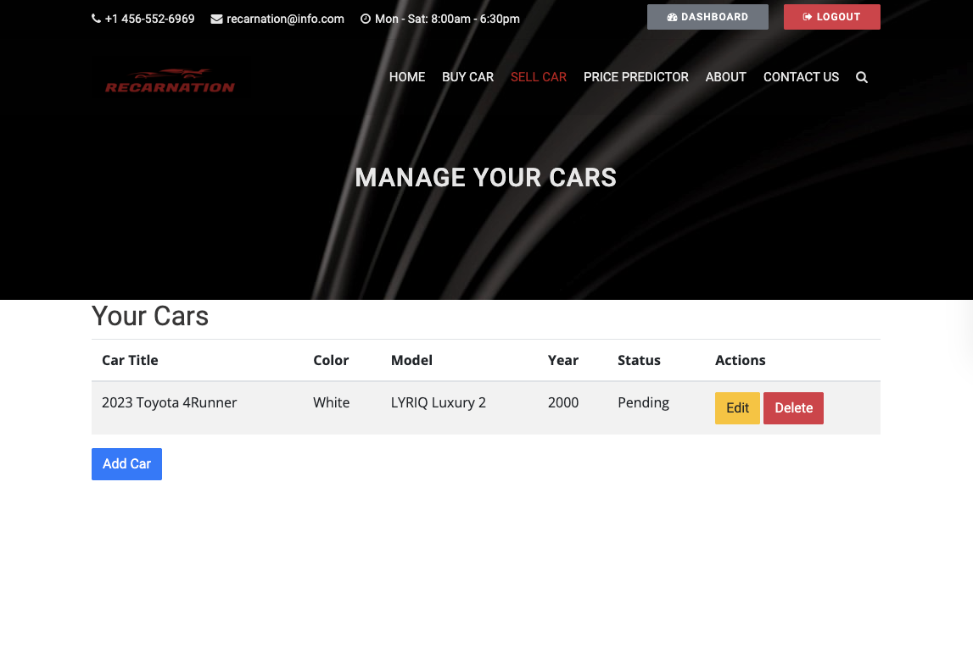
Seller Journey: Listing Your Vehicle
1
Simple Listing Creation
Listing a car on ReCarNation is easy and intuitive. The platform provides a clear and concise form with detailed fields for car information.
2
Comprehensive Information
Sellers can input all relevant details about their car, including vehicle history, maintenance records, and any potential issues.
3
Image Uploads
Users can upload high-quality photos of their car, showcasing its condition, features, ensuring potential buyers have a clear picture.
4
Listing Management
ReCarNation empowers sellers to manage their listings, adjust prices, respond to inquiries.

Slide 9
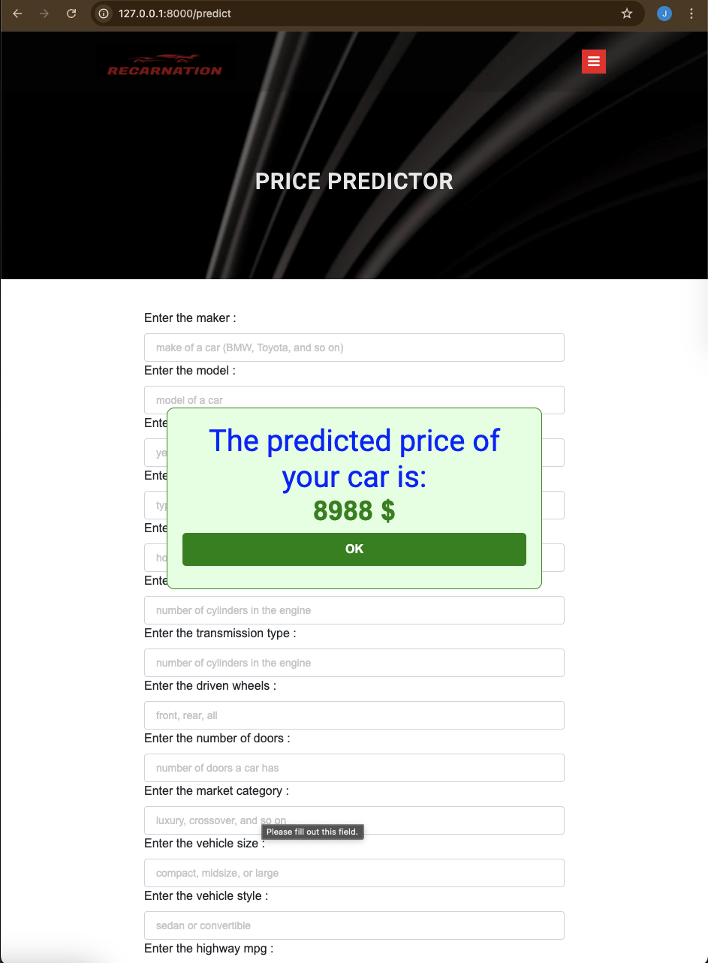
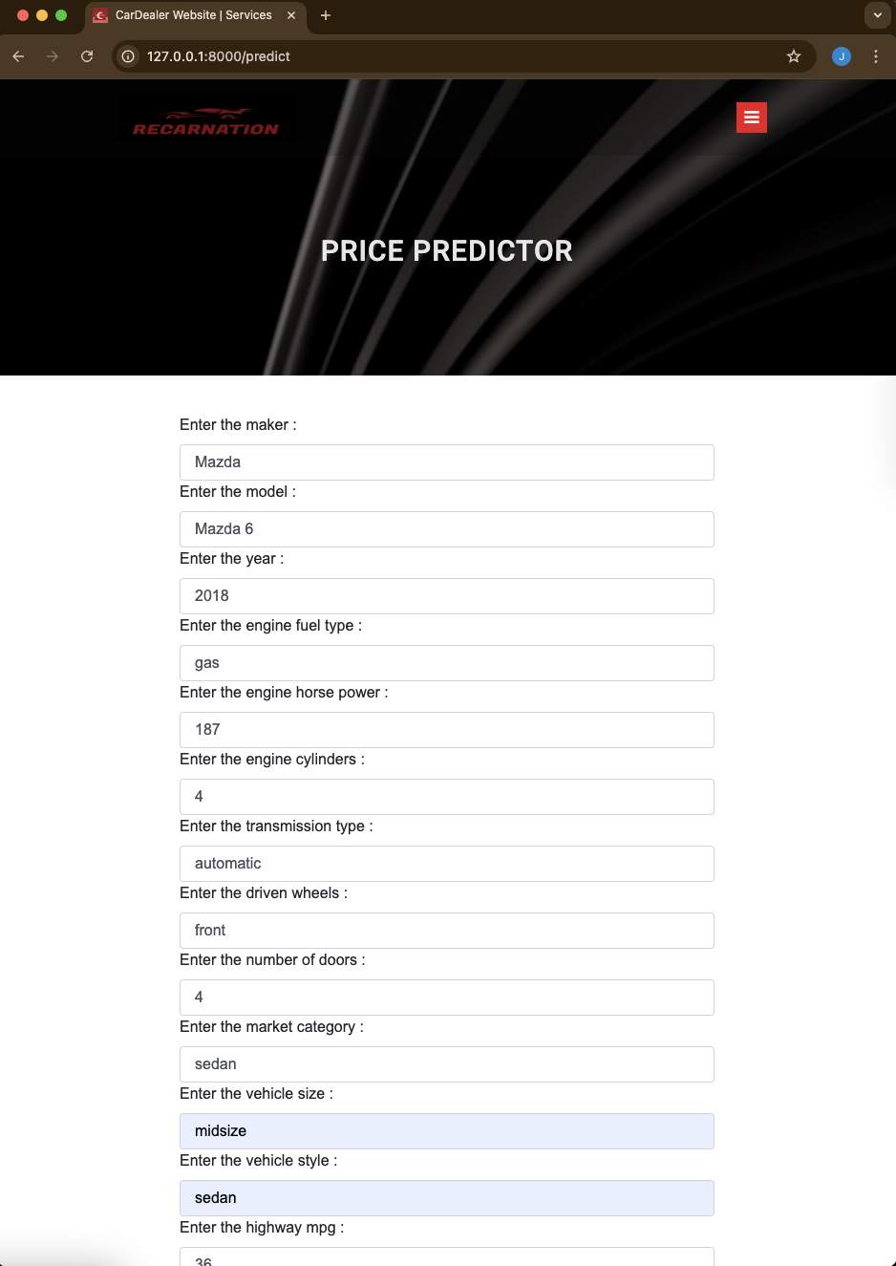
Vehicle Price Prediction Using Linear Regression
Data preprocessing and splitting into training, validation, and test sets.
Building and optimizing a regression model with regularization.
Using the model for accurate vehicle price predictions.

Slide 10
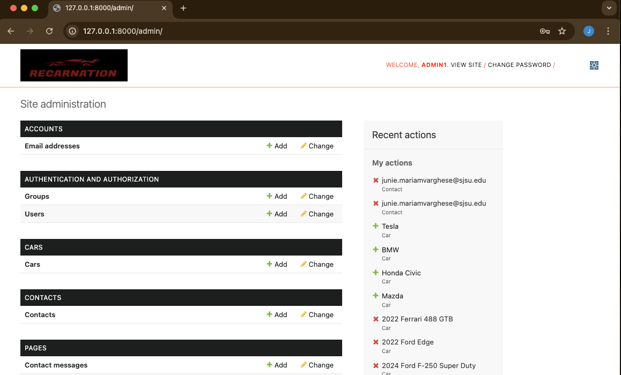
ReCarNation: Admin Management System
Listing Approval Workflow
Administrators can review, approve, or reject listings before publication, ensuring a high-quality and trustworthy marketplace.
Handle permissions
Administrators have control over user permissions to maintain platform integrity and security.
Manage vehicles
They can also manage sold and unsold vehicles, including updating or removing listing details as needed..

Slide 11
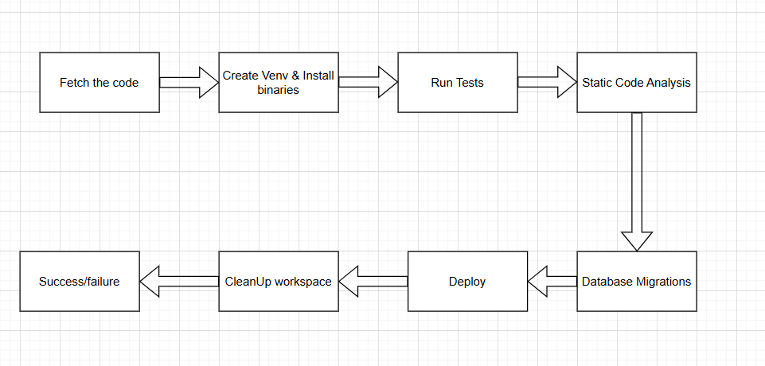
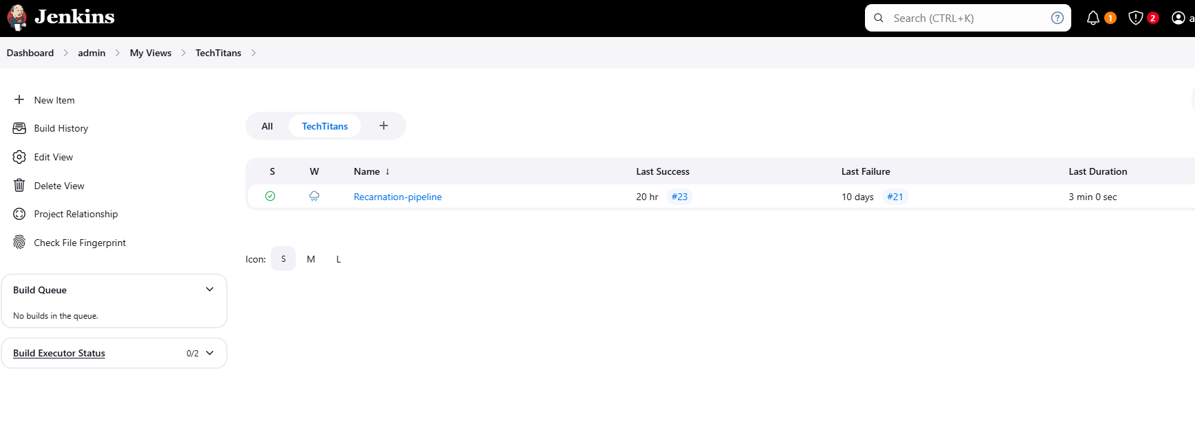
Jenkins CI/CD Integration

Slide 12
Future Enhancements
Make the machine learning model better to give more accurate price predictions for cars.
Host the entire application on the cloud for better reliability and access from anywhere.
Make it Global: add support for different languages, and allow payments in various currencies to reach more people worldwide.

Slide 13
Thank You

